Slide 1

Hibernate 5
Dima Ionut Daniel

Slide 2
Contents
What is Hibernate ?
Features
Architecture
Core
Persistence Context
Identifiers
Entities
Cascading Operations
Session
Caching
Searches and Queries
Conclussion
Bibliography

Slide 3

What is Hibernate ?
Hibernate ORM is an object-relational mapping framework written in Java .
Hibernate is free software that is distributed under the GNU Lesser General Public License.
Hibernate's primary feature is mapping from Java classes to database tables (and from Java data types to SQL data types).
Applications using Hibernate are portable to supported SQL databases with little performance overhead.

Slide 4
Features
Mapping Java classes to database tables is accomplished through the configuration of an XML file or by using Java Annotations.
One-to-many and many-to-many relationships between classes are supported.
Hibernate provides an SQL inspired language called Hibernate Query Language (HQL).
Criteria Queries are provided as an object-oriented alternative to HQL.
Hibernate supports the mapping of custom value types:
Overriding the default SQL type that Hibernate chooses when mapping a column to a property.
Mapping Java Enum to columns as if they were regular properties.
Mapping a single property to multiple columns

Slide 5
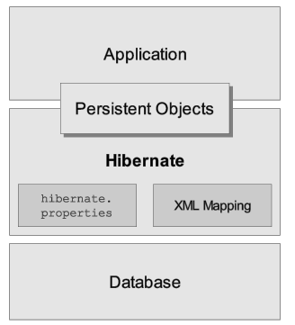
Architecture
High-level view of the Hibernate architecture

Slide 6
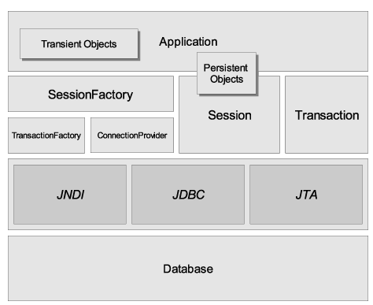
Architecture (cont.)
Hibernate architecture

Slide 7
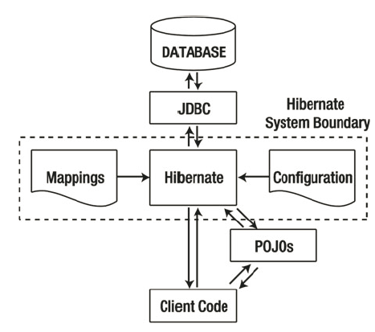
Architecture (cont.)
Hibernate usage

Slide 8
Core
Hibernate needs meta-data(mapping) to understand which tables relate to which objects.
Mappings can be provided either through Java annotations or through an XML mapping file.
Hibernate uses JDBC connections in order to interact with DB.
Hibernate uses JDBC connections in order to interact with DB.
Hibernate is designed to us a connection pool by default (internal implementation).
We can plug other connection pool implementations like: C3P0, Proxool.

Slide 9
Persistence Context
There are 4 states for an object in relation to a session:
persistent
transient
detached
removed

Slide 10
Persistence Context (cont.)
When we create a new object, the initial state is transient.
When we call save() on a new object we're marking the object as "persistent".
A detached object is a persistent object whose session has been closed or has been evicted from a Session.
A removed object is one that's een marked for deletion in the current transaction.
An object is changed to removed state when Session.delete() is called.

Slide 11
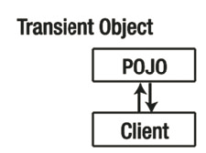
Persistence Context (cont.)
Transient objects exists in memory.
Hibernate does not manage transient objects or persist changes to transient objects.

Slide 12
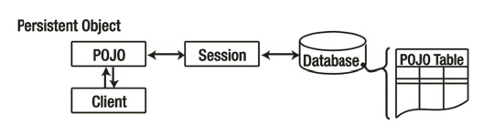
Persistence Context (cont.)
Persistent objects exists in the database and Hibernate manages the persistence for persistent objects.
To persist the changes to a transient object we need to interact with the session to save the object in the database.

Slide 13
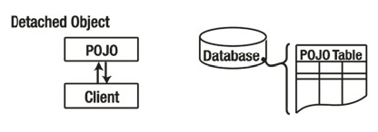
Persistence Context (cont.)
Detached objects have a representation in the database but changes to the object will not be reflected in the database and vice versa.
A detached object can be created by closing the session that it was associated with or by evicting it from the session (sesson.evict()).

Slide 14
Identifiers
An identifier, or identity column maps to the concept of a primary key in relational databases.
A primary key is a unique set of one or more columns that can be used to specify a particular collection of data.
In Hibernate, an object attribute is marked as an identifier with the @Id annotation.
The @GeneratedValue annotation tells Hibernate that who is responsible for assigning and maintaining the identifier.
There are 5 different generation possibilities: identity, sequence, table, auto and none.

Slide 15
Entities
Entities can contain references to other entities.
The association can be unidirectional or bidirectional.
Entities are marked with the @Entity annotation.
There are 4 types of associations: one-to-one, one-to-many, many-to-one, many-to-many.

Slide 16
Entities (cont.)
Merging is performed when we want to have a detached entity changed to persistent state again with the detached entity's changed migrated to the database.
Merging is the inverse of refresh(), which overrides the detached entity's values with the values from the database.

Slide 17
Entities (cont.)
Hibernate automatically persists changes made to persistent objects into the database.
If a property changes on a persistent object, the associated Hibernate session will queue the change for persistence to the database using SQL.
We can determine the session is dirty and changed needs to be commited and change Hibernate flushing mode using setHibernateFlushMode().
We can retrieve the FlushMode that Hibernate uses also.

Slide 18
Entities (cont.)
Available flush modes:
ALWAYS: every query flushed the session before the query is executed. This affects performance.
AUTO: Hibernate manages the query flushing to guarantee that the data returned by a query is up to date.
COMMIT: Hibernate flushed the session on transaction commits.
MANUL: Application needs to manage the session flushing with the flush() methods.
By default Hibernate uses AUTO flush mode.

Slide 19
Entities (cont.)
In order to delete the entities from database we can use session.delete() method.
We can do bulk delete using the Query object.
session.createQuery("delete from <custom_object>").executeUpdate();

Slide 20
Cascading Operations
When operations affect associated entities, they're referred to as "cascading" operations because actions flow from one object to another.
Cascade types supported by the JPA:
PERSIST
MERGE
REFRESH
REMOVE
DETACH
ALL

Slide 21
Cascading Operations (cont.)
Hibernate has a facility called lazy loading.
When enabled an entity's associated entities will be loaded only they are directly requested, which can provide performance benefits.
If an association of the class is accessed and lazy loading is in effect the association is pulled from the database only as needed.
Hibernate can force this behavior using proxy.

Slide 22
Cascading Operations (cont.)
Hibernate can access DB date via a session.
If an entity is detached from the session when we try to access an association that has not yet been loaded, Hibernate throws a LaxyInitializationException.
We can determine whether a proxy, a persistence collection or an attribute has been lazy loaded by calling the isInitialized() and isPropertyInitialized() methods from Hibernate class.

Slide 23
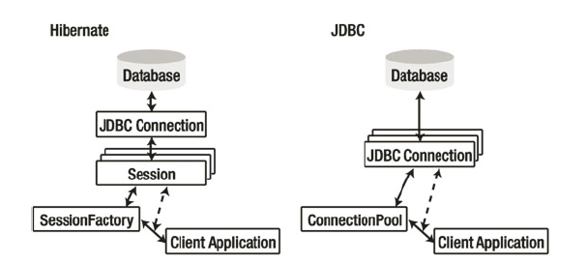
Session
The Session object is the central point of access to Hibernate functionality.
The Session object is used for CRUD operations
SessionFactory objects are expensive objects and threadsafe so it's best to cache them.
Sessions in Hibernate are not threadsafe so sharing Session objects between threads could cause data loss or deadlock.

Slide 24
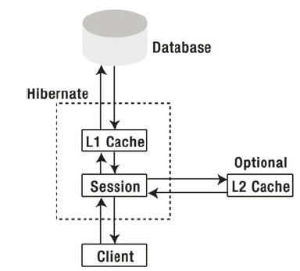
Caching
Accessing a database is an extensive operation.
Hibernate provides L1 cache and optional (and configurable) L2 cache.
The L1 cache ensures that within a session, requests for a given object from DB will return the same object instance.
Items from L1 cache can be discarded by invoking the evict() method on the session.
To discard all items in the L1 cache we need to call clear() method.

Slide 25
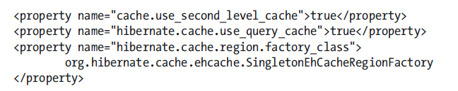
Caching (cont.)
The org.hibernate.cache.CacheProvider interface is provided for L2 cache.
The cache provider can be specified using the hibernate.cache.provider_class property.
L2 cache implementations supported by Hibernate: EHCache, Infinispan, OSCache, SwarmCache.

Slide 26
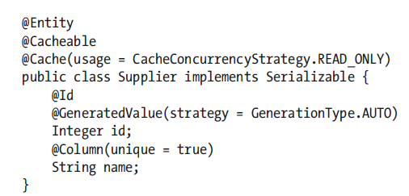
Caching (cont.)
The type of access to the L2 cache can be configured on a per-session basis by selecting a CacheMode option (setCacheMode() method).
NORMAL: data is read from and written to the cache
GET: data is never added to the cache
PUT: data is never read from the cache, but cache entries will be updated as they are read from the DB.
REFRESH: same with PUT, but the use_minimal_puts configuration option will be ignored
IGNORE: data is never read/written to the cache.

Slide 27
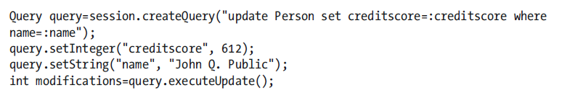

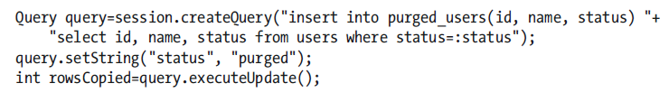
Searches and Queries
Hibernate Query Language(HQL) is an object-oriented query language similar to SQL.
It is a superset of the JPQL(Java Persistence Query Language).
A JQPL query is valid but not vice versa is valid every times.

Slide 28
Conclussion
PROS:
Portability
Maintainability
Free
Popular
Documented

Slide 29

Bibliography
https://en.wikipedia.org/wiki/Hibernate_%28Java%29
Apress - Beginning Hibernate

Slide 30
Questions ?

